Slide 1


Presenting for:
Tsamis • Andrianopoulou • Manthos

Slide 2


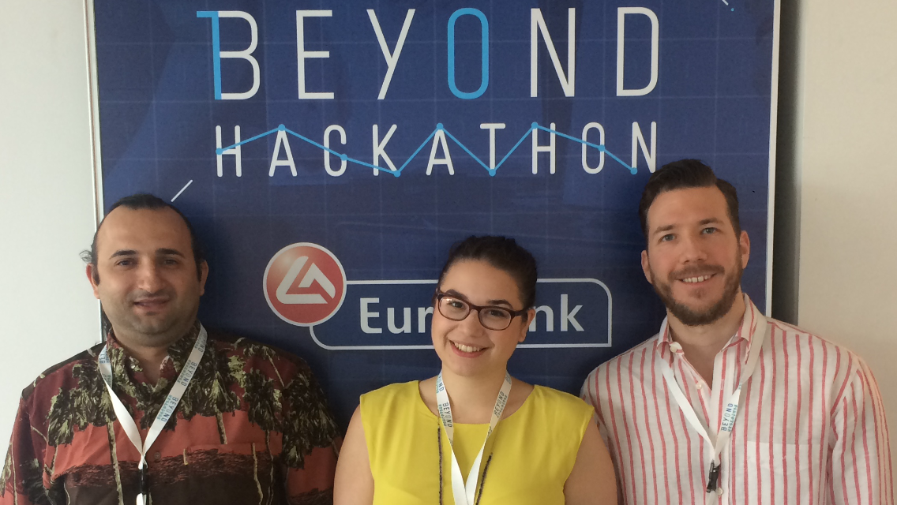
The Team
Dimitris
Konstantinos
THE DEVELOPER
Studies Computer Science at Uppsala University, when not at sea
Interested in algorithms and scientific innovations
THE MARKETER
Studies CEMS/ International Management at the Stockholm School of Economics
Interested in Strategy, Technology and Change Management
Christina
THE UX DESIGNER
Studies Software Engineering at KTH in Stockholm
Interested in new technologies and innovative design

Slide 3
The easy and rewarding way to improve the lives of the underprivileged

Slide 4
The Idea & the Goal
WHAT IS IT ALL ABOUT?
Mobile App enabling e-banking customers donate the amount of money they wish to support causes raised by participating NGOs
WHAT DO WE WANT TO ACHIEVE?
Digitalize charity contributions and increase transparency in the donation process

Slide 5
The Business Model shapes a “W/W/W” situation for the Bank/Charities/Customers

Slide 6

The Business Model
Wide donators base
Decreased spending on campaigns
Moral Satisfaction
Points to spend on loyalty program
Customer
Charity
pts.
Strong CSR profile
Increased loyalty effect
Capital inflow from other banks
info
Bank
The Scheme Enabler
Partners of a CSR heavy bank
Increased clientele
Moral Satisfaction
Monetary Satisfaction: Initial investment + Base fee + Success fee
Partners

Slide 7
Unique Selling Proposition
WHY US?
Dedicated team with complementary skills
Our background differences are not a burden due to our team-working abilities
Connection with loyalty program
Further involve customers with the main loyalty scheme
Mobile App
Easy and direct way to interact with the charities

Slide 8
Specially designed app interface to enhance the positive emotions of giving

Slide 9
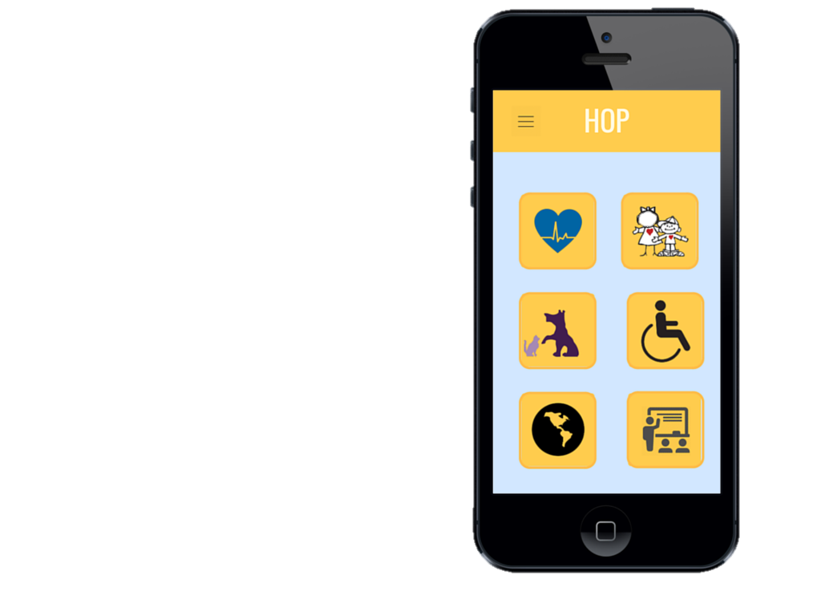
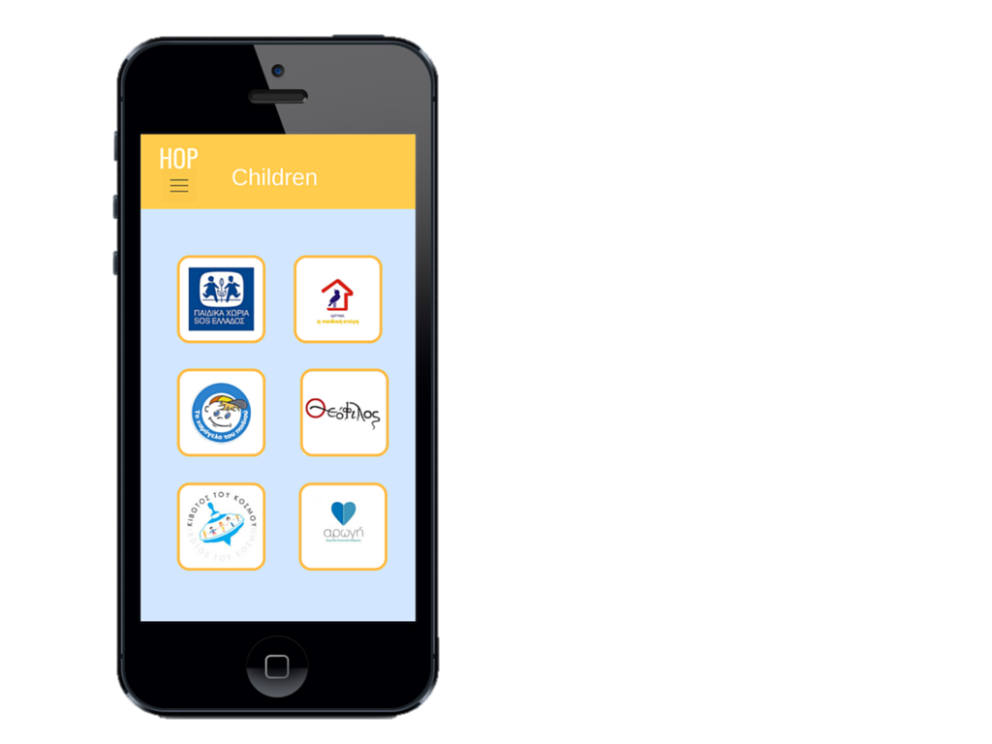
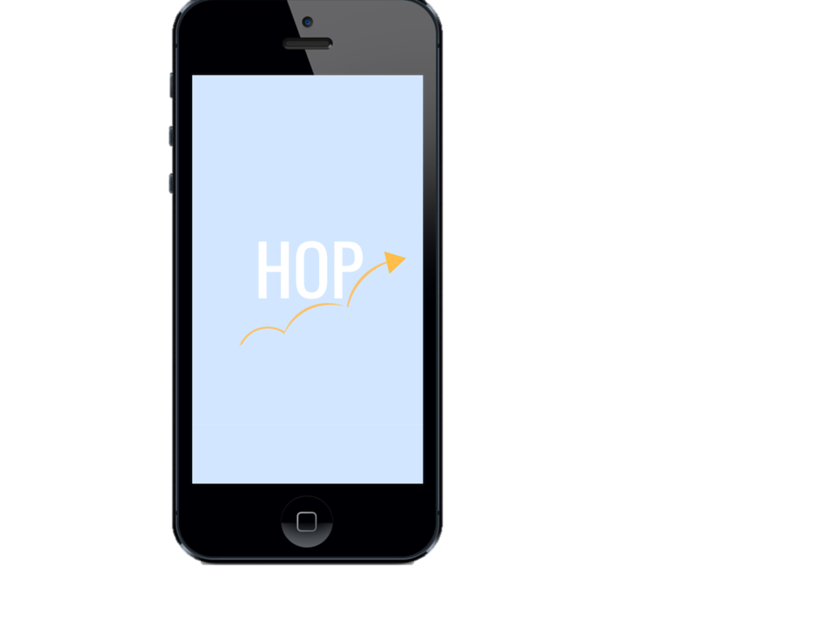
Welcome screen
Categories
Participating Charities

Slide 10
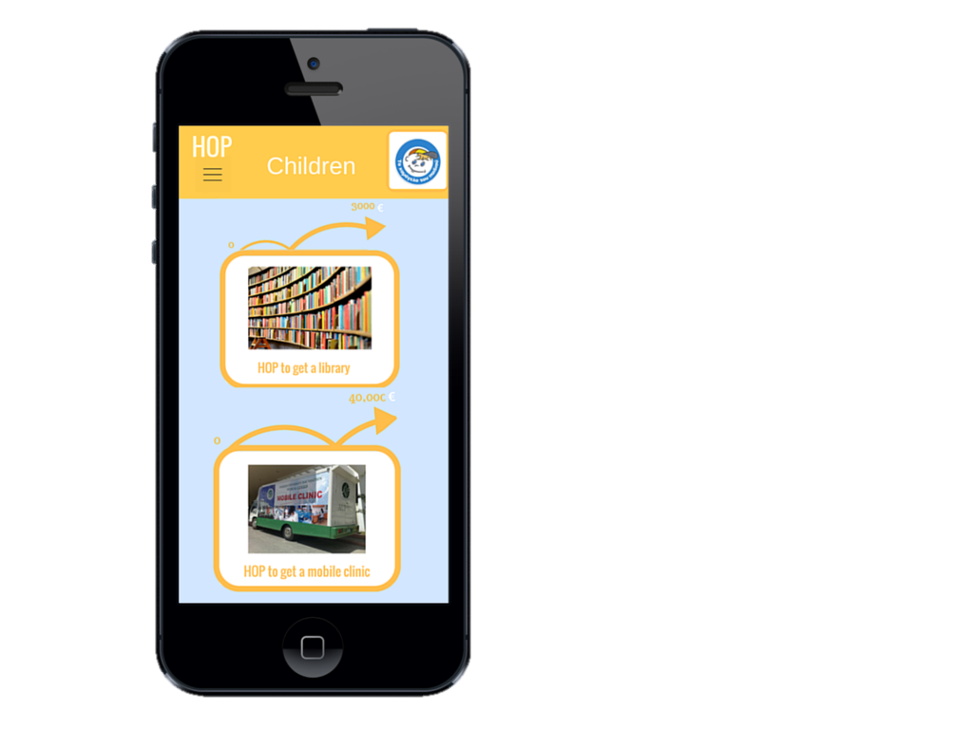
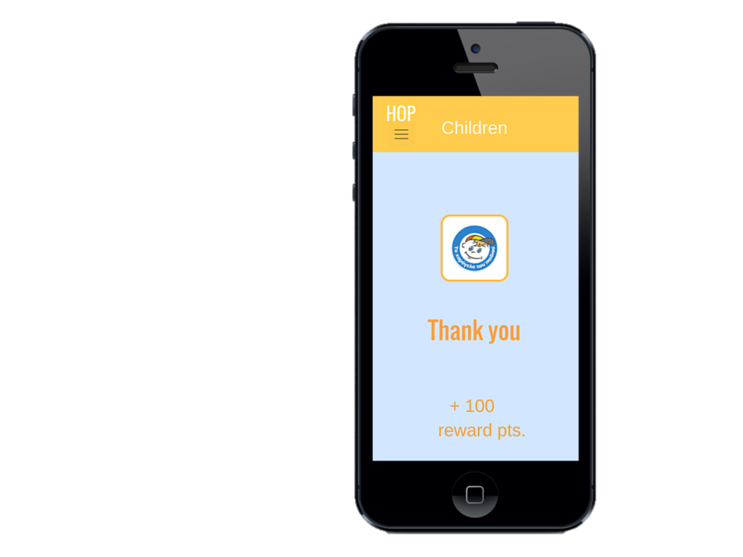
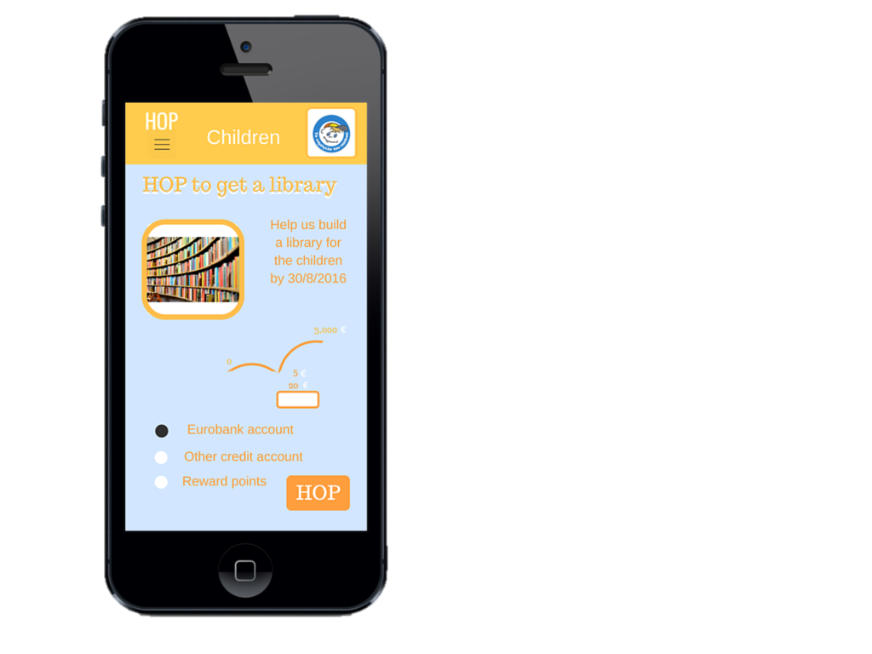
Available campaigns
Donation step
Reward feedback

Slide 11
We create an app for the present with our minds on the future

Slide 12
Future Steps
OUR LONG-TERM GOALS INCLUDE:
B2C & B2B transactions in the donation process
Find new ways for customers to donate through everyday purchases
International operations
Create similar apps for foreign banks
Larger-scale campaigns
Increase the average asking donation

Slide 13
Thank you! Q&A

